Slide 1

Internship Review 2
Organization Name : Whirlpool Corporation (GTEC)
Domain : Data Analytics (Informatica Developer)
Name - Om Parag Butala
Class - CS-C-3 BTech
PRN - 22120149
Guide : Prof. Namrata Wasatkar
Industry Manager : Nitin Phuke
Industry Mentor : Mohit Shrivastava

Slide 2

Problem statement
To develop the mapping workflows as per the technical requirements from different stakeholders related to Sales, Promotions, Products, Orders, Service etc. and supporting the same. Also, monitoring and troubleshooting existing tasks when abended/suspended. Also learning the admin side activities (Repository Management, Server Management, User Management) for ETL Informatica.

Slide 3
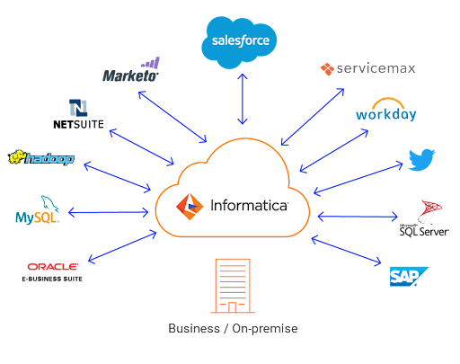
Internship Planning
Advanced SQL
Data warehousing
Informatica PowerCenter
Informatica Intelligent Cloud Services(IICS)
Working to ongoing Project

Slide 4
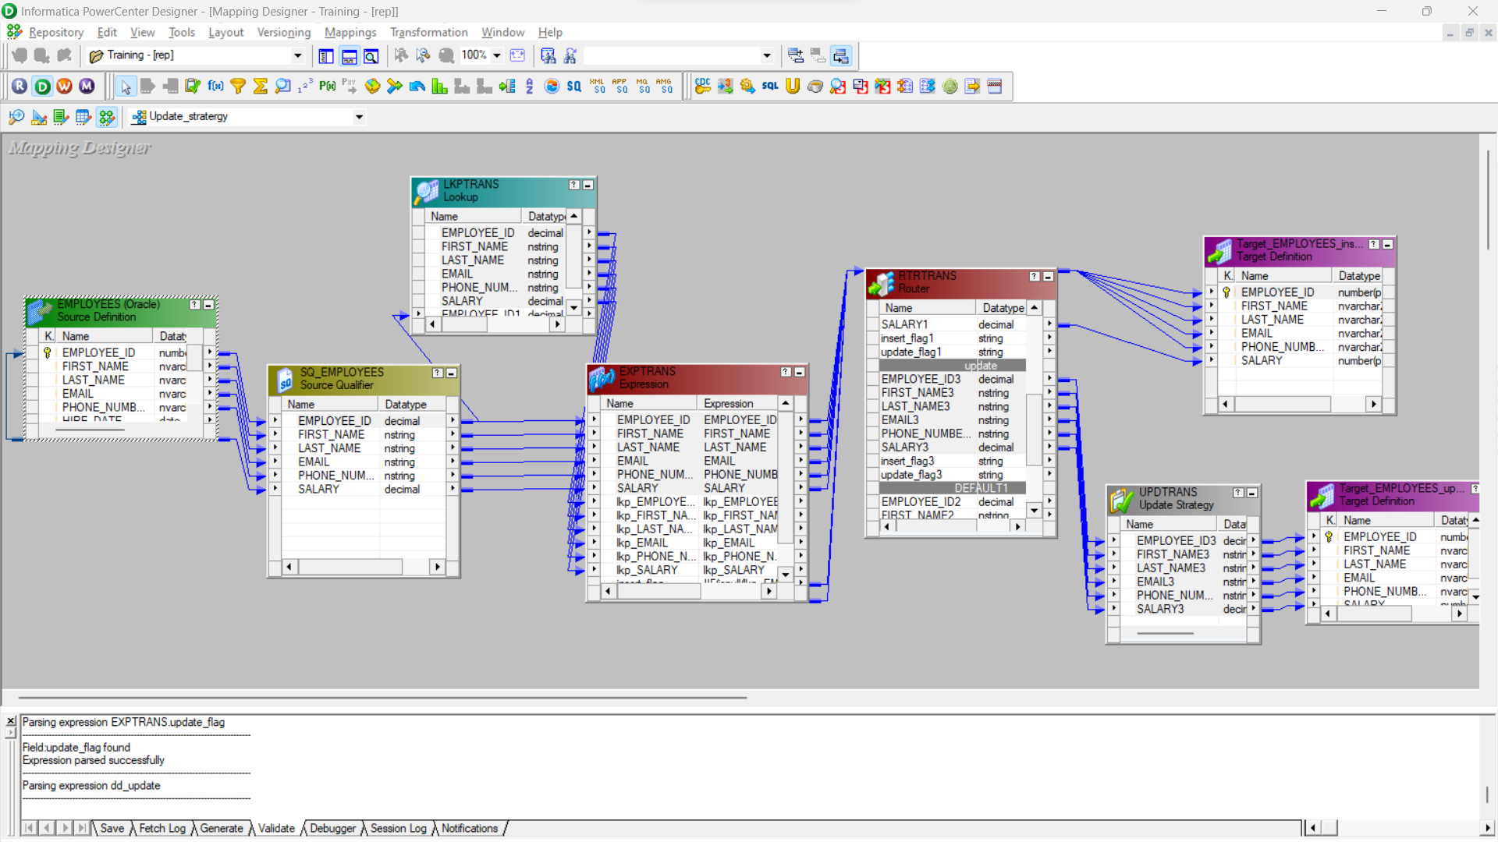
Use Case/ Example
SCD (type-1) Update Strategy:

Slide 5
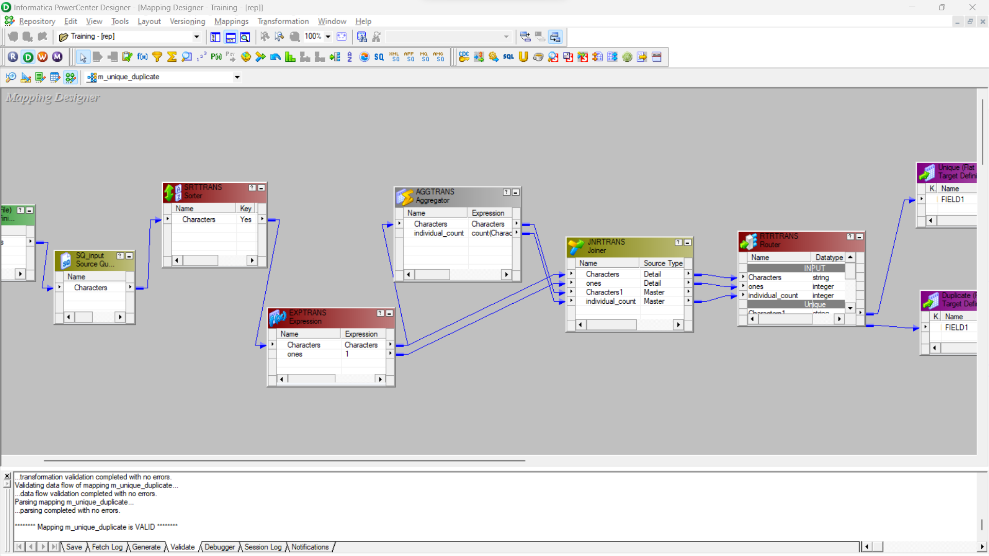
Load unique records in one file and duplicate records in second file without losing records

Slide 6
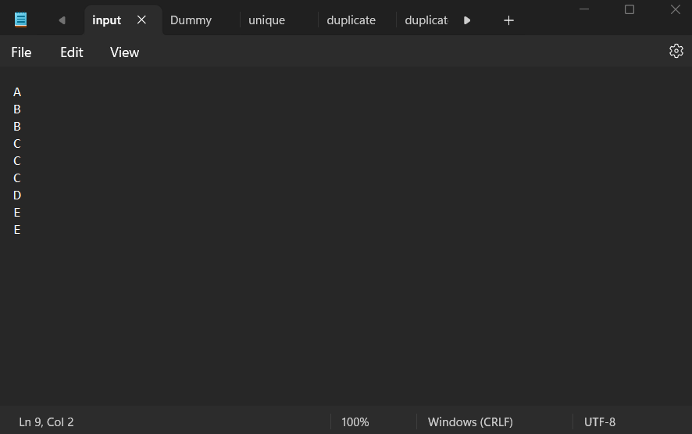
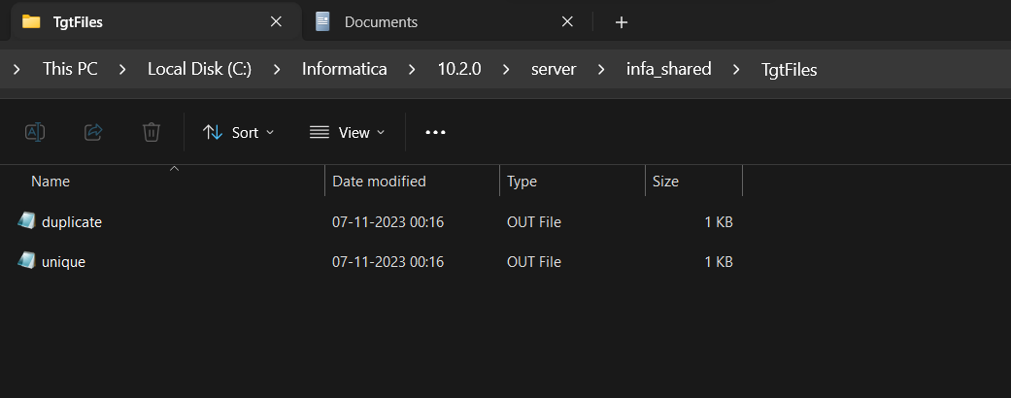
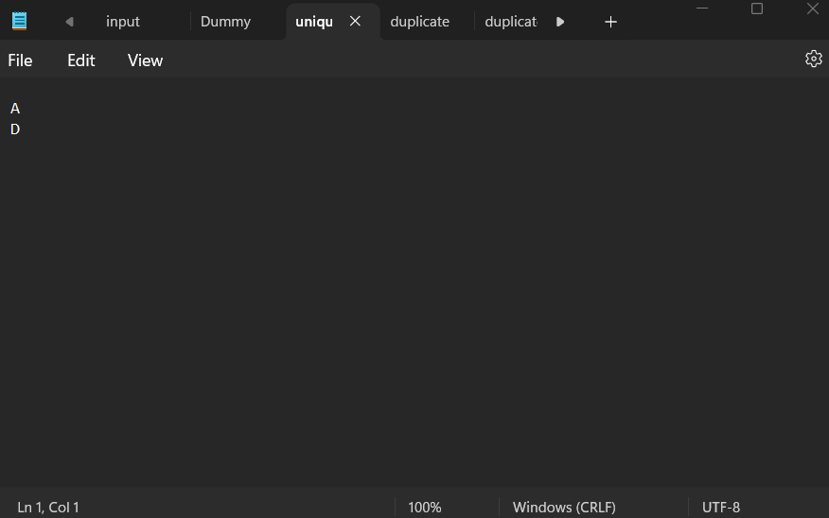
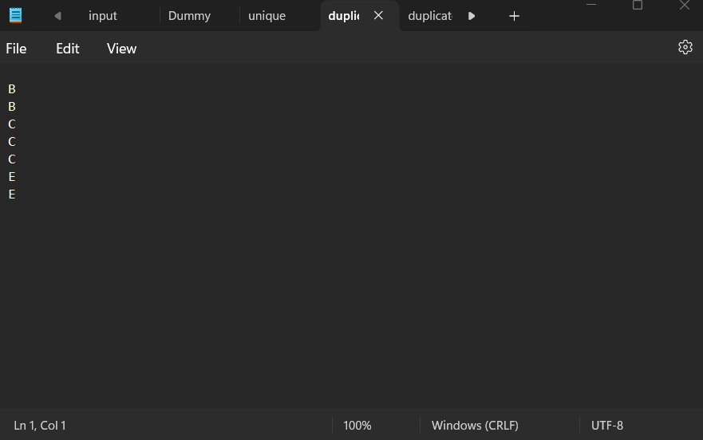
Output:

Slide 7


